Slide 1
Quantum Circuit 1 Problem
Mike La Barbera

Slide 2
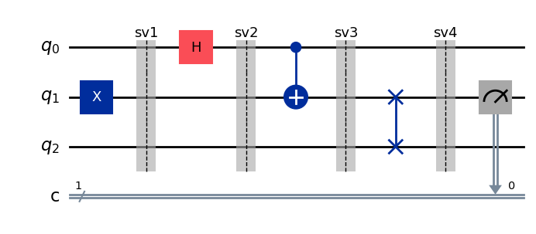
Circuit Output and Statevectors
Question: 1.) Explain the results shown in Statevector 4

Slide 3
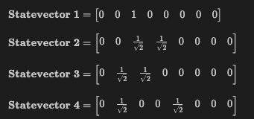
Circuit Output and Statevectors
Question: 1.) Explain the results shown in Statevector 4. Below is the output of the statevectors for the quantum circuit from your py file

Slide 4
Explanation of Circuit and Statevector
We begin with a Statevector 0 and create table of SV’s and kets:
Statevector number | Statevector | Ket(s) | Binary to Base 10 (position in SV)
0 | [1 0 0 0 0 0 0 0] | |000>
1
2
3
4

Slide 5
Explanation of Circuit and Statevector
Reference circuit on slide 2 and begin by applying X gate on q1:
Statevector number | Statevector | Ket(s) | Binary to Base 10 (position in SV)
0 | [1 0 0 0 0 0 0 0] | |000>
1
2
3
4

Slide 6
Explanation of Circuit and Statevector
Reference circuit on slide 2 and begin by applying X gate on q1:
Statevector number | Statevector | Ket(s) | Binary to Base 10 (position in SV)
0 | [1 0 0 0 0 0 0 0] | |000> | 0
1 |  | |010> | 2
2
3
4

Slide 7
Explanation of Circuit and Statevector
Next is a Hadamard gate on q0 which yields a superposition
Statevector number | Statevector | Ket(s) | Binary to Base 10 (position in SV)
0 | [1 0 0 0 0 0 0 0] | |000> | 0
1 | [0 0 1 0 0 0 0 0] | |010> | 2
2
3
4

Slide 8

Explanation of Circuit and Statevector
Next is a Hadamard gate on q0 which yields a superposition.
Let’s calculate:

Slide 9
Explanation of Circuit and Statevector
Next is a Hadamard gate on q0 which yields a superposition.
Let’s calculate:

Slide 10

Explanation of Circuit and Statevector
Next is a Hadamard gate on q0 which yields a superposition.
Let’s calculate:

Slide 11

Explanation of Circuit and Statevector
Next is a Hadamard gate on q0 which yields a superposition.
Let’s calculate:

Slide 12

Explanation of Circuit and Statevector
Next is a Hadamard gate on q0 which yields a superposition.
Let’s calculate:
Superposition of states: 0 ket goes to 0 or 1 ket multiplied by the scalar 1/sqrt(2)

Slide 13

Explanation of Circuit and Statevector
Next is a Hadamard gate on q0 which yields a superposition.
Let’s calculate:
Superposition of states: 0 ket goes to 0 or 1 ket multiplied by the scalar 1/sqrt(2). That is |010> goes to both

Slide 14
Explanation of Circuit and Statevector
Fill in the kets found in prior slide
Statevector number | Statevector | Ket(s) | Binary to Base 10 (position in SV)
0 | [1 0 0 0 0 0 0 0] | |000> | 0
1 | [0 0 1 0 0 0 0 0] | |010> | 2
2 |  | |010>,|011>
3
4

Slide 15
Explanation of Circuit and Statevector
Fill in the kets found in prior slide and compute binary
Statevector number | Statevector | Ket(s) | Binary to Base 10 (position in SV)
0 | [1 0 0 0 0 0 0 0] | |000> | 0
1 | [0 0 1 0 0 0 0 0] | |010> | 2
2 |  | |010>,|011> | 2,3
3
4

Slide 16

Explanation of Circuit and Statevector
Ticks at position 2,3 in the SV and let
Statevector number | Statevector | Ket(s) | Binary to Base 10 (position in SV)
0 | [1 0 0 0 0 0 0 0] | |000> | 0
1 | [0 0 1 0 0 0 0 0] | |010> | 2
2 | k[0 0 1 1 0 0 0 0] | |010>,|011> | 2,3
3
4

Slide 17
Explanation of Circuit and Statevector
Back to slide 2, we have a CNOT gate q0 is control, q1 is terminal
Statevector number | Statevector | Ket(s) | Binary to Base 10 (position in SV)
0 | [1 0 0 0 0 0 0 0] | |000> | 0
1 | [0 0 1 0 0 0 0 0] | |010> | 2
2 | k[0 0 1 1 0 0 0 0] | |010>,|011> | 2,3
3
4

Slide 18
Explanation of Circuit and Statevector
Back to slide 2, we have a CNOT gate q0 is control, q1 is terminal
Taking the two kets found from before we take:
No action on the ket since q0 is 0.
Ket becomes since q0=1 is activated, q1 becomes 0
Back to the table

Slide 19
Explanation of Circuit and Statevector
Fill in the results so far for SV3 and back to slide 2:
Statevector number | Statevector | Ket(s) | Binary to Base 10 (position in SV)
0 | [1 0 0 0 0 0 0 0] | |000> | 0
1 | [0 0 1 0 0 0 0 0] | |010> | 2
2 | k[0 0 1 1 0 0 0 0] | |010>,|011> | 2,3
3 | k[0 1 1 0 0 0 0 0] | |010>,|001> | 2,1
4

Slide 20
Explanation of Circuit and Statevector
Back to slide 2 we have a CSWAP gate on q1, q2:
Statevector number | Statevector | Ket(s) | Binary to Base 10 (position in SV)
0 | [1 0 0 0 0 0 0 0] | |000> | 0
1 | [0 0 1 0 0 0 0 0] | |010> | 2
2 | k[0 0 1 1 0 0 0 0] | |010>,|011> | 2,3
3 | k[0 1 1 0 0 0 0 0] | |010>,|001> | 2,1
4

Slide 21
Explanation of Circuit and Statevector
CSWAP gate on q1, q2 simply swaps the classical bits in the kets:
Statevector number | Statevector | Ket(s) | Binary to Base 10 (position in SV)
0 | [1 0 0 0 0 0 0 0] | |000> | 0
1 | [0 0 1 0 0 0 0 0] | |010> | 2
2 | k[0 0 1 1 0 0 0 0] | |010>,|011> | 2,3
3 | k[0 1 1 0 0 0 0 0] | |010>,|001> | 2,1
4 |  | |100>,|001>

Slide 22
Explanation of Circuit and Statevector
Note is a fixed ket in this instance of CSWAP since both q2,q1 is zero.
Statevector number | Statevector | Ket(s) | Binary to Base 10 (position in SV)
0 | [1 0 0 0 0 0 0 0] | |000> | 0
1 | [0 0 1 0 0 0 0 0] | |010> | 2
2 | k[0 0 1 1 0 0 0 0] | |010>,|011> | 2,3
3 | k[0 1 1 0 0 0 0 0] | |010>,|001> | 2,1
4 | k[0 1 0 0 1 0 0 0] | |100>,|001> | 4,1

Slide 23
Explanation of Circuit and Statevector
Congratulations you’ve found SV4 by hand! ☺
Statevector number | Statevector | Ket(s) | Binary to Base 10 (position in SV)
0 | [1 0 0 0 0 0 0 0] | |000> | 0
1 | [0 0 1 0 0 0 0 0] | |010> | 2
2 | k[0 0 1 1 0 0 0 0] | |010>,|011> | 2,3
3 | k[0 1 1 0 0 0 0 0] | |010>,|001> | 2,1
4 | k[0 1 0 0 1 0 0 0] | |100>,|001> | 4,1

